Slide 1

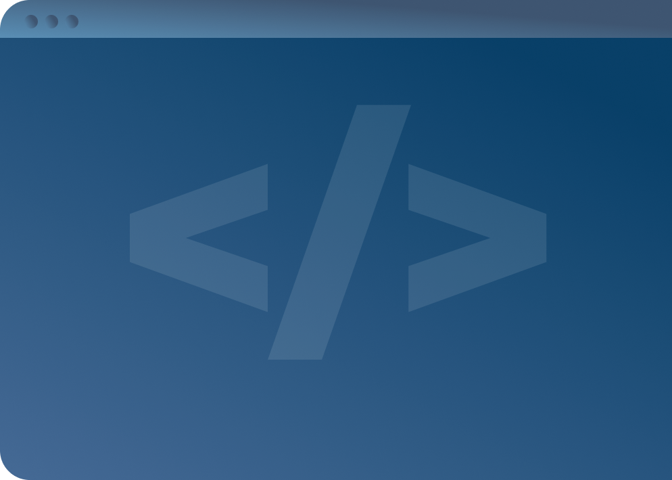

SOFTWARE DEVELOPMENT PROFESSIONAL PROGRAM
Web Development in Context

Slide 2





Web Development in Context
Learning Objectives
Define the terms browser and server.
Describe the purpose of back-end programming.
Describe the purpose of front-end programming.

Slide 3

Web Development in Context
Computers
Notes:
Early computers were essentially fancy calculators capable of receiving input, solving problems,
and displaying output;
if you wanted to change the function of the machine you had to re-wire and re-structure it.
To overcome this limitation, stored-program computers were created.
These computers store in memory a set of instructions (a program) that details the computation to be run.
Before the 1950s, developers had to translate their mathmatical equations into machine code (binary);
Grace Hopper changed the programming world by developing the first compiler and later the first
programming language that used entirely English words (FLOW-MATIC).

Slide 4

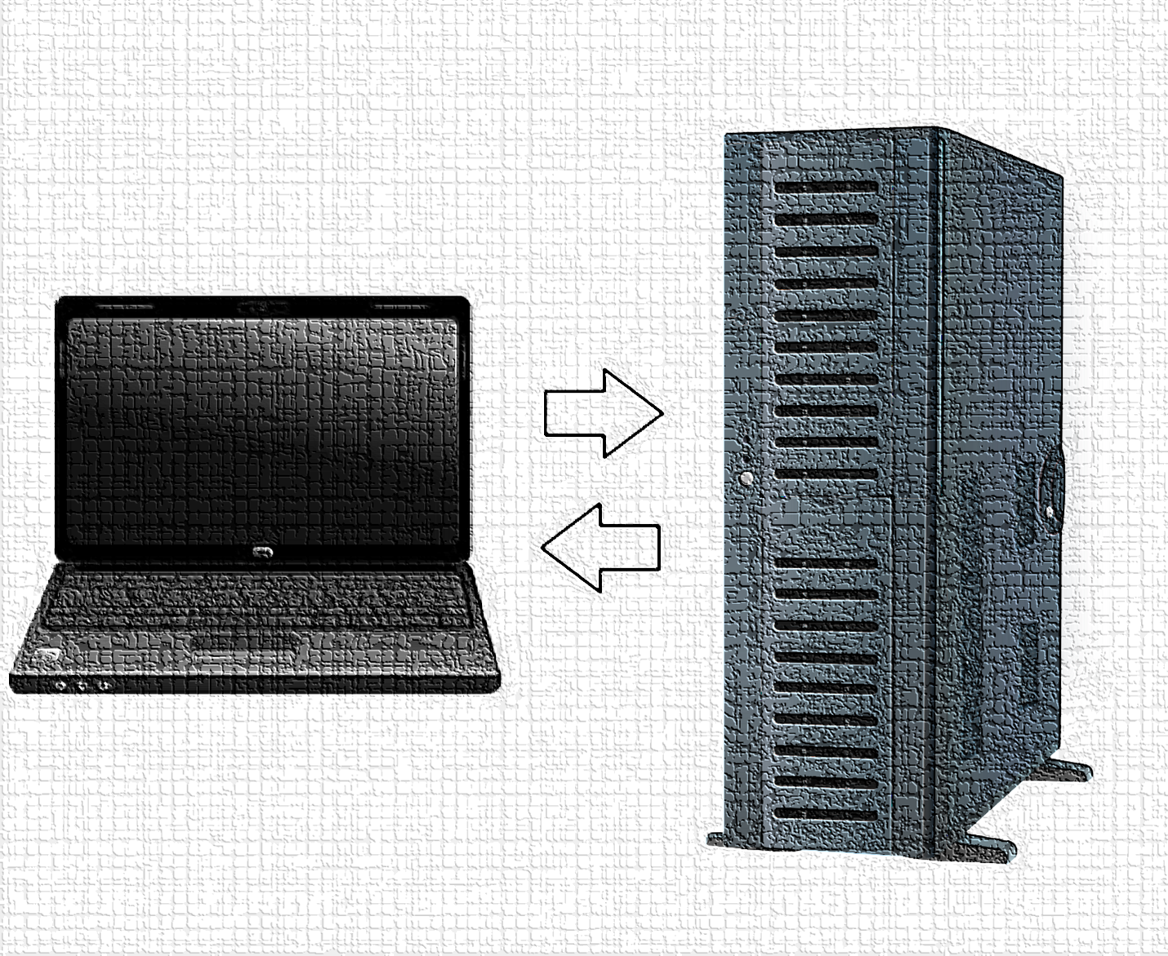
Web Development in Context
Networking
Notes:
The internet is, at its core, a way for computers to communicate.
The internet "officially" began in the late 60s as a way to connect university computers in the US over the
already-existing national phone network. By the late 80s, the internet as we know it was beginning to take shape
through applications (domain names, email, file transfer, etc.), internet communication (routing, TCP/IP etc.),
and ethernet networking (dedicated internet cables that replaced the old phone-network system).
In the 90s, the combination of home computers and the invention of the World Wide Web (HTTP)
grew the internet exponentially.
In the last decade, there has been a huge centralization of internet infastructure as cellular companies
focus on internet service and cloud computing/storage hosts most modern services.
<< Summarized from Dr. Spencer Sevilla.>>

Slide 5


Web Development in Context
The Internet: Clients & Servers
The Client
The Server
Sends requests
Responds to requests
Example: Asks for store hours.
Example: Responds that the hours are 9 a.m. to 10 p.m.
Notes:
Connecting computers to one another resulted in the internet.
Computers connected to the internet take on two roles:
1. Clients—usually make requests to servers
2. Servers—usually send responses to clients
<< Exercise 1: What is a server (in your own words)? >>

Slide 6


Web Development in Context
Browsers
Chrome
Edge
Firefox
Etc.
Notes:
The most common type of client is a browser. A browser is software that a human can use to make
requests to servers through the internet.
<< Exercise 2: What is a browser (in your own words)? >>

Slide 7
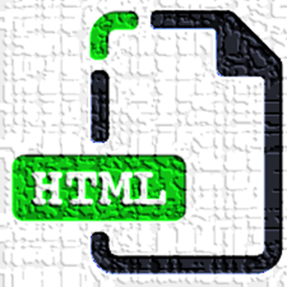


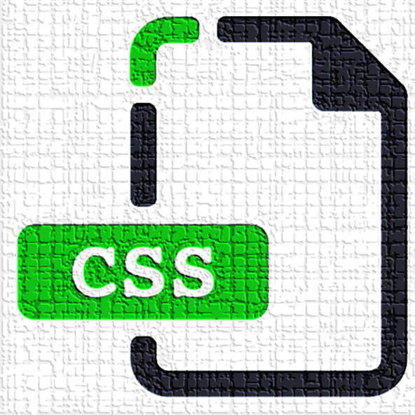


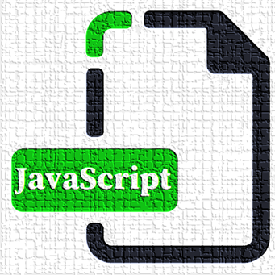
Web Development in Context
Static Websites
+
=
+
Notes:
Static by definition means something that does not change. A static website contains web pages (HTML)
with fixed content;
it delivers the same content to everyone who visits the site, regardless of context.
While the user may be able to interact with the site through JavaScript,
the *content* only changes when the creators manually change it
(as opposed to being programatically updated by a server).
Example: https://agilemanifesto.org/ (nothing but text, images, and links)
<< Exercise 3: What is a static website (in your own words)? >>

Slide 8

Web Development in Context
Discussion: Static Websites
What are some examples of static websites you've visited in the past?
Notes:
<< You can also ask, "What kind of websites wouldn't need to change their content regularly?" >>

Slide 9

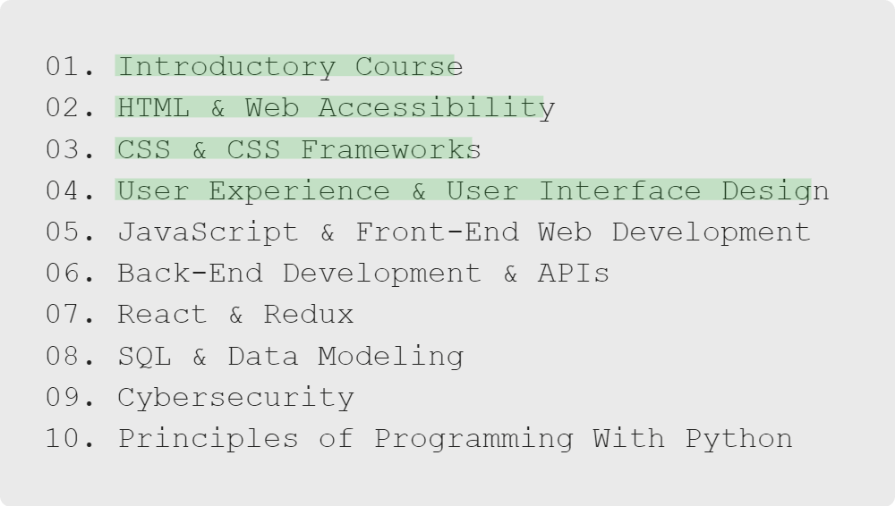
Web Development in Context
Roadmap
Notes:
We'll introduce HTML and CSS early in the introductory course.
Then, in the first three courses of the extended program, we'll dive deeper into both of them,
and cover the UX and UI skills necessary to create an impactful user experiences with them.

Slide 10
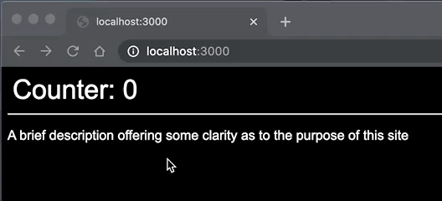

Web Development in Context
Back-End Programming
+
+
=
+
Notes:
As websites get bigger and bigger, it becomes more work to maintain the site and all its pages.
Amazon has over 300 million products-how do they maintain all of those pages?
There is not a developer hand-crafting each page. Instead, they have teams of programmers writing code
that the server uses to create HTML, CSS, and even JavaScript programmatically.
This also keeps the website up-to-date because the server can safely access data from a database and
programatically put it into the pages they deliver to the client.
<< Draw the attention of learners to the delay between when the user clicks and when the page updates.
Talk about how that's a result of the browser waiting on the server to rebuild the HTML. >>
<< Exercise 4: What is back-end programming (in your own words)? >>

Slide 11







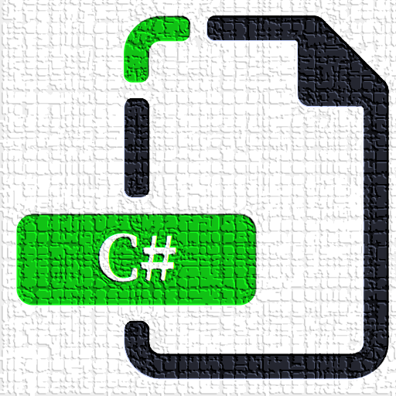
Web Development in Context
Back-End Languages
Or
Or
Or
Or
Or
Or
Notes:
There are a lot of languages that can be used on servers and developers are still making more!

Slide 12
Web Development in Context
Discussion: Back-End Programming
What are some examples of websites you've visited in the past that use back-end programming?
Think of some websites where you experienced a noticeable delay anytime the page changed.
Notes:
<< Use some of the static website examples as a comparison. Ask learners,
"what websites need to be personalized?" >>

Slide 13
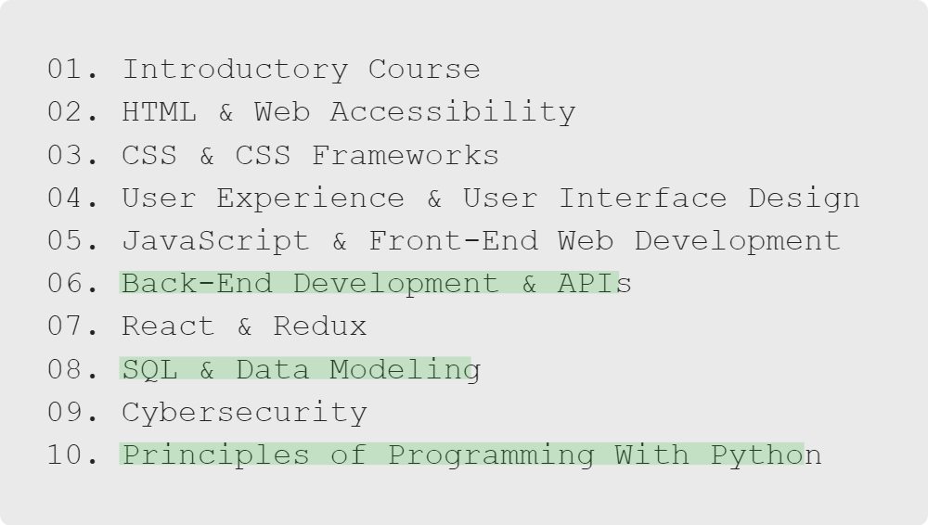
Web Development in Context
Roadmap
Notes:
We'll explore back-end programming multiple times in the extended program.
First, we'll introduce the concepts of back-end programming using JavaScript in course 6.
We'll touch on integrating back-end programming and data storage at the end of course 8.
Then, as we near the end of the program, we'll revisit those concepts in Python, giving us
an opportunity to compare and contrast two different languages that accomplish the same task.

Slide 14
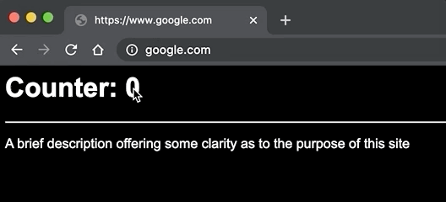
Web Development in Context
Front-End Programming
+
=
+
Notes:
Front-end programming relates to the webpage that the user interacts with. Initially, a developer would create
a webpage with HTML (JavaScript and CSS support came in 1996). The browser would make a request to the server
and the server would then send the stored files in an HTTP response.
While that process still happens today with static webpages, developers also came up with a more complicated,
yet more flexible way of delivering content to a user. Dynamic websites generally utilize a server to recover
data and process it **before** sending the response back to the client, allowing webpages to contain
interactive, continually changing elements.
<< Exercise 5: What is front-end programming (in your own words)? >>

Slide 15
Web Development in Context
Discussion: Front-End Programming
What are some examples of websites you've visited in the past that use front-end and back-end programming?
Think of websites where the page changed very often, without much delay.
Notes:
These could be SPAs that use Ajax, or apps that run fully in the browser. The idea
is that the content of the webpage is affected by the user.

Slide 16
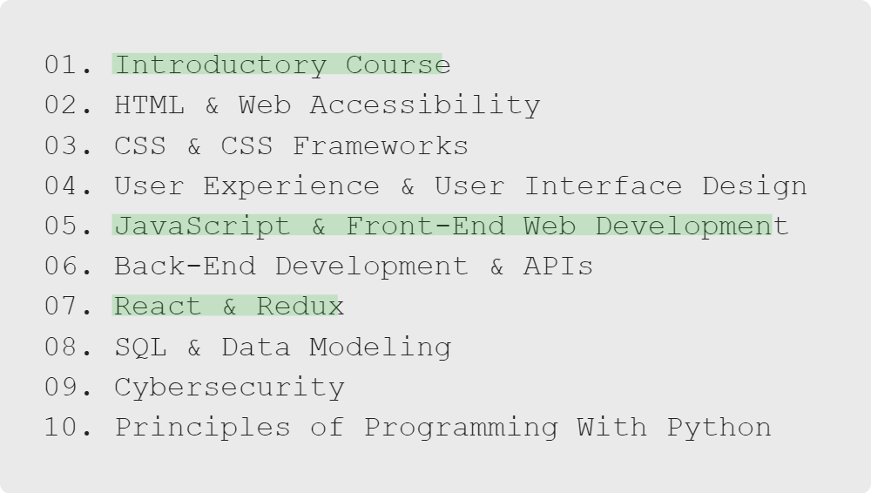
Web Development in Context
Roadmap
Notes:
Later in the introductory course, we'll begin to build dynamic websites with JavaScript.
Then, in the fifth course of the extended program, we'll take a closer look at JavaScript and learn to build
more complex front-end web applications.
In course 7, we'll look at one of the most popular JavaScript libraries used in front-end programming: React.

Slide 17
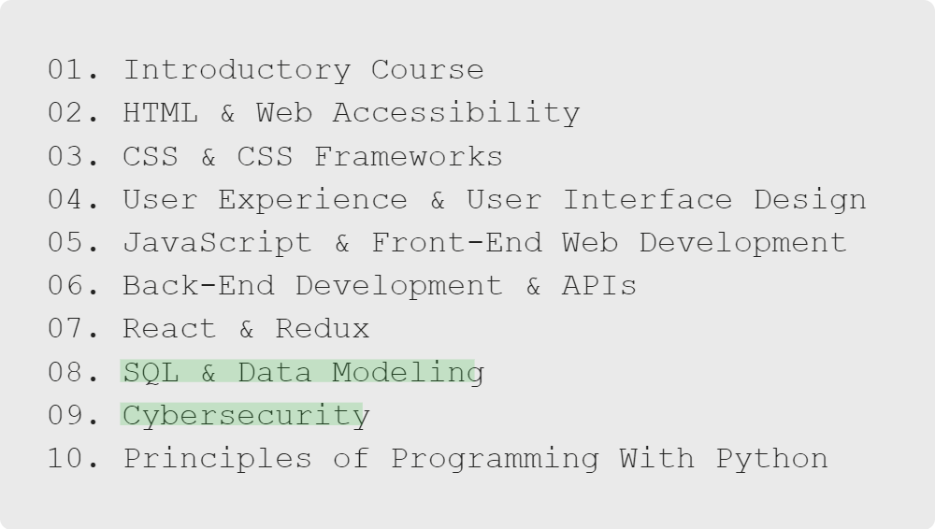
Web Development in Context
Roadmap
Notes:
In course 8, we'll learn about how to store and access data through Structured Query Language (SQL), eventually
integrating it with what we learned about back-end programming in course 6.
We'll cover cybersecurity in the context of both front-end and back-end programming
as we near the end of the program in course 9.

Slide 18

Web Development in Context
Career Readiness
What's a Career in This Field Like?
Notes:
Let's take a step back for a moment and discuss what a career in Software Development looks like.

Slide 19

Video Clip
Web Development in Context
Picture Yourself Here
Imagine something you like to do... playing video games, making art, improving healthcare or education.
There is a software developer behind all of these experiences!
You'll need a healthy mix of passion, problem-solving ability, and both communication and collaboration skills.
Notes:
Congratulate the students on taking the first step towards a new career. It can be scary to start something new,
switch to a new industry, and enroll in a bootcamp. Celebrate this choice, commend them for their efforts.
After covering the bulleted list:
Advise learners you’ll be sharing content giving a personal perspective from TDX instructors throughout the course.
<< Share the clip from the Instructors Panel video of how a few started in the industry.
https://digitalskills.hosted.panopto.com/Panopto/Pages/Viewer.aspx?id=2d41eb6e-9d54-4540-80a9-ae5c015e7df2 >>

Slide 20
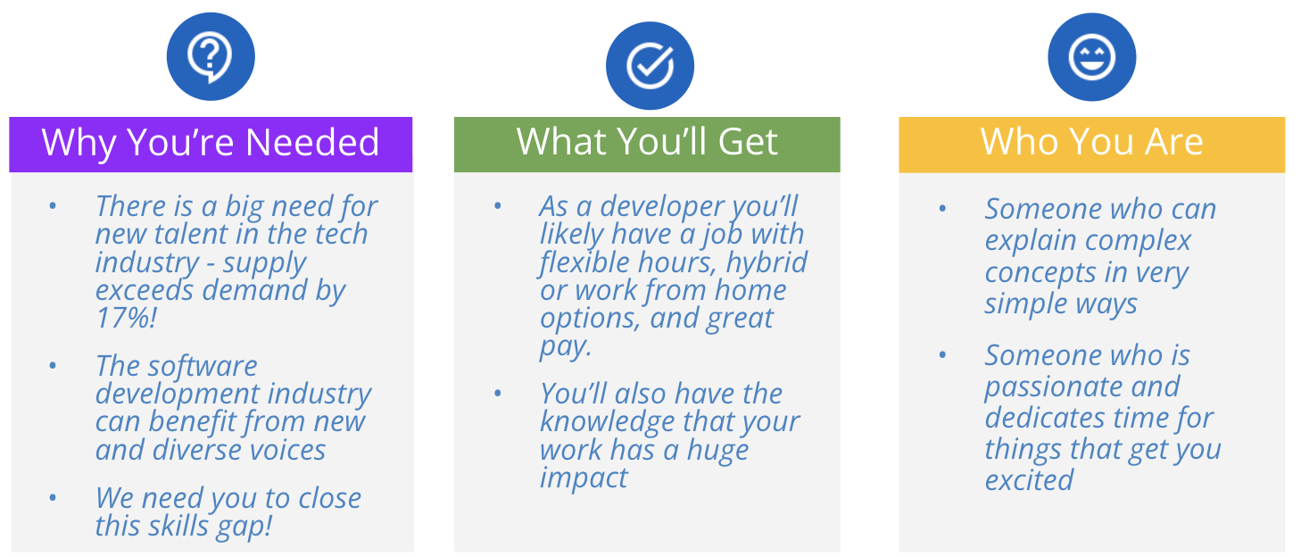
Web Development in Context
You and Your Career
Video Link
Notes:
Dig deep here, show the students the importance of their role within the industry.
Why should they choose THIS job, THIS career?
Highlight diversity and inclusion within the industry.
<< Share the instructor perspective video on how you can impact positive change.
https://digitalskills.hosted.panopto.com/Panopto/Pages/Viewer.aspx?id=dbd6665a-e766-4a0c-8e3b-ae5c015ee214 >>

Slide 21

Web Development in Context
Let's Chat
When did you become interested in coding?
What is a software developer's day-to-day like?
What kinds of companies and industries need developers?
Notes:
Use this time for Q&A and let the learners ask about you own career journey to becoming a developer.
Draw on as much personal experience as you can.

Slide 22

Web Development in Context
Summary
You've Got This!
Today you have learned about:
Browsers
Static websites
Server and back-end programming
Client and front-end programming
The request and response cycle
Notes:
Let's see how your computer can function as both a client and a server!

